Slide 1
Digital Forensics & Incident Response
Windows DFIR | Acquisition
Mohammed Hasan

Slide 2
RAM Acquisition
RAM footprint
Kernel-Mode Tools
BelkaSoft RAM Live Capture
DumpIt V1.3.2
User-Mode Tools
FTKImager
Mohammed Hasan

Slide 3
Disk Acquisition
Encryption Detection
Magnet EDD
Full Disk Acquisition
FTKImager
QuickWin Artifacts Acquisition
Kape
WinTriage
Mohammed Hasan

Slide 4
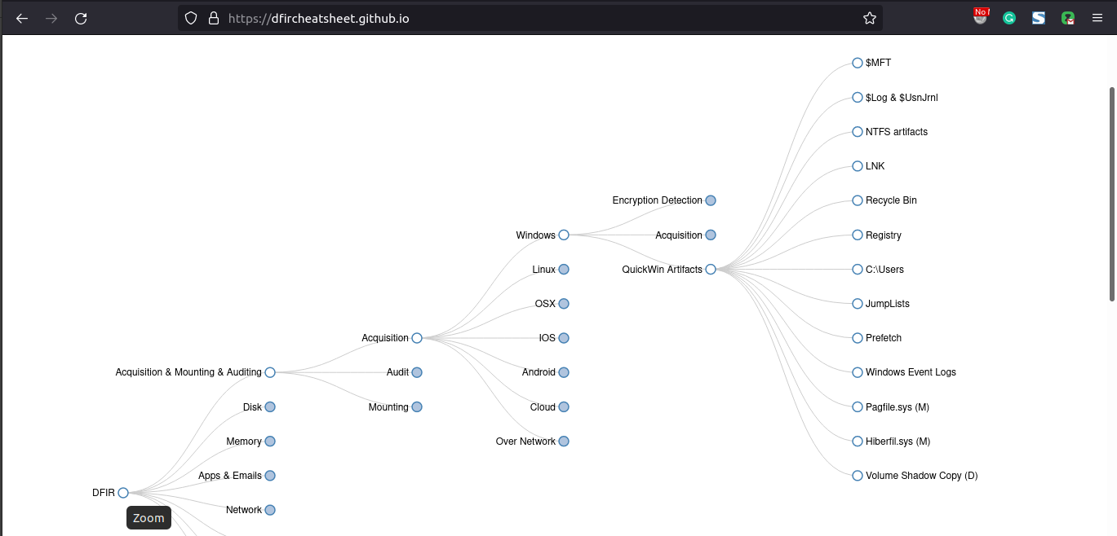
QuickWin Artifacts
99 percent of the necessary evidence typically will exist in 1-2 percent of the data acquired
Mohammed Hasan

Slide 5

Thanks for Watching
Contact: 0xHasanM
Mohammed Hasan

